Slide 1

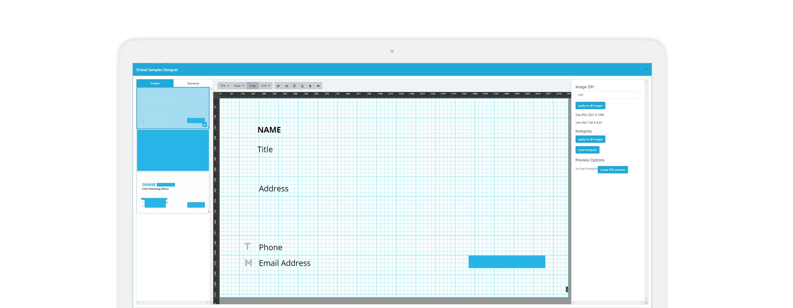
Virtual Samples/Variable Data
SALES TEAM PRESENTATION

Slide 2



Current Feature Description
Allow your shoppers to build virtual product samples based on logo choices and personalization input. Virtual Sample can be used as a proofing system and basic design studio. Advanced Virtual Samples uses high-quality images and your printer’s DPI settings for a layered PDF file that’s ready to print.

Slide 3

Feature Highlights
CURRENT KEY FEATURES
Product Templates
Shopper Personalization
Fonts & Font Styles
Product Proofs & Approvals
Layered PDF Files
Much Easier to Use

Slide 4

Competitors

Slide 5

Custom Ink
Feature Name: Design Lab
Price: Price is by item, depending on customization. T-shirts are $20.00
Competitors
B2B PRINT & PROMO
InkSoft
Feature Name: Online Designer
Price: $299/month + $1999 one-time. HOWEVER, this comes with 13k+graphics also they charge $49 for a 50 store pack
Proforma
Feature Name: ProStores
Price: Starts at $50/mo. and then included in the bundle for large stores
Lucidpress
Feature Name: Lucidpress Editor
Price: $50/month
Print Job
Feature Name: No Name
Price: $99/month (5 different plans)
Others in industry with this feature:
eBlox
Web Jaguar
4Imprint
Four51

Slide 6
Competitors
Vista Print
Feature Name: Editor
Price: Quantity Pricing = 100/$15.00
GENERAL PRINT & DESIGNERS
Staples
Feature Name: Create Your Own
Price: Quantity Pricing = 250/$34.99; 1000/$49.99
Volusion
Feature Name: Content Builder
Price: $26.00/month
Moo
Feature Name: Editor
Price: Quantity Pricing = 250/$135.00
Canva
Feature Name: Designer
Price: Quantity Pricing = $12.95/user/year

Slide 7
Competitors
Vista Print: Live Proofing
Moo/Canva: Super Easy Designer for Non-Designers
ProStores: Dynamic Paragraphing/Field Show
Lucidpress: Various Download Options
MOST IMPRESSIVE FEATURES

Slide 8
Feature Wishlist

Slide 9
Storefront Wishlist
FEATURES WE WANT
Variable Fields
Upload Multiple File Types
Flip Button for Front/Back Live Proofing
Choose File Size Download
MOAS or Email Proof Option

Slide 10
Admin Wishlist
FEATURES WE WANT
Bleed Marks on Designer
Lock Format in Admin (other admins can’t change)
Upload Personalizations (like an address book)
Easier Interface Option for Non-Designers
Basic Template Layouts

Slide 11
Potential Feature Names

Slide 12
Per Wikipedia: Variable data printing (VDP) also known as variable information printing (VIP) or variable imaging (VI)) is a form of digital printing, including on-demand printing, in which elements such as text, graphics and images may be changed from one printed piece to the next, without stopping or slowing down the printing process and using information from a database or external file.

Slide 13

Name Brainstorm
Variable Data
Virtual Samples
Anna’s Desk
Bright Design
Product Designer
Fresh University

Slide 14
Marketing Plan

Slide 15
Promotion Plan
Website Updates
Sales Sheet Updates
Weekly Demo Recording
20 Second Showcase Demo
Email Campaigns
Webinars
Press Release to PPAI
PPAI Newslink Newsletter Advertising
Print+Promo Newsletter Advertising
Key Accounts Direct Mailer Gift
Exclusive Admin Access to a Demo Store
GETTING THE WORD OUT

Slide 16

Questions?

